Slide 1
IYPT №13
Alex, Tasin, Ned, Arthur

Slide 2
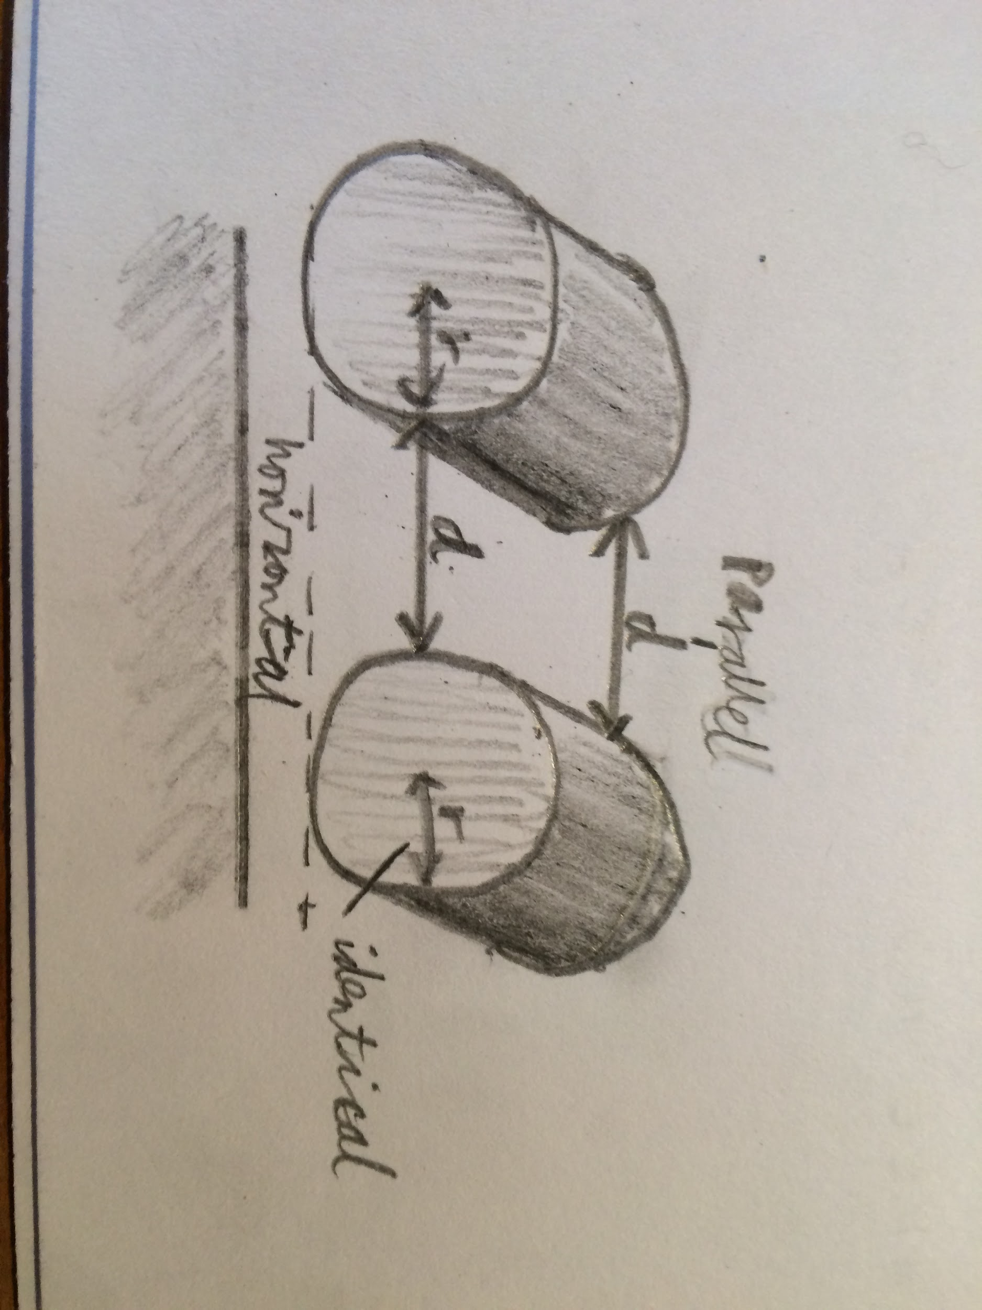
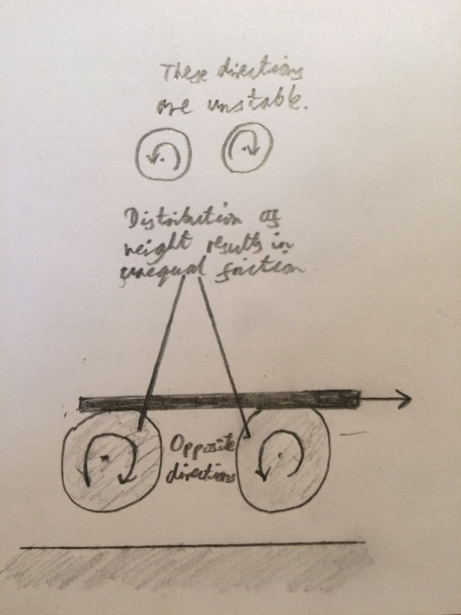
What is the problem asking?
13.Friction Oscillator
A massive object is placed onto two identical parallel horizontal cylinders. The two cylinders each rotate with the same angular velocity, but in opposite directions. Investigate how the motion of the object on the cylinders depends on the relevant parameters.
We need to record the motion of an object as contact with a friction oscillator causes it to move.
‘A massive object’ - A solid with mass. The mass is constant as it is an object rather than a complex system.
‘The motion...depends on the relevant parameters’ - factors affecting the object’s displacement and its derivatives.
‘Two identical parallel horizontal cylinders’ ‘Rotate...in opposite directions’

Slide 3
Relevant Formulae
W = mg To find the force of weight of the massive object.
Fբ = μFₙ To find the frictional force. The kinetic coefficient of friction (μₖ) is more important here than the static one (F=ma). (μₛ) as only the start of the motion would be affected by the static coefficient of friction.So,in the most of time of this experiment,the only formula that we can use is f=F=ma( This is the formula to calculate the kinetic friction which means that the material of objects and cylinders is not a main factor and we can ignore the influence of it in the experiment).
V = d/t To find the velocity of the massive object as it informs us about the massive object’s motion. We could also find further derivatives such as acceleration which also affect the f according to F=ma.
P = mv To find the momentum of the massive object, so as to compare the motion of objects of different mass.

Slide 4
Stage 1
Object in equilibrium, moving right. The forces of friction acting on the object have the same magnitude, but opposite directions, so the net force is 0. Object has obtained momentum after stage 8, pointing right
Quantitative:
Horizontal displacement from the centre is s
Horizontal velocity is v
Horizontal acceleration is a
Weight on cylinder 1 is W₁
N₁ is the normal force exerted by the first cylinder
N₂ is the normal force exerted by the second cylinder
F₁ is the frictional force exerted by the first cylinder
F₂ is the frictional force exerted by the second cylinder
Fₜ is the total frictional force
S = 0
v > 0
W₁ = W₂ = N₁ = N₂
F₁ = μN₁
F₂ = μN₂ = -F₁
Fₜ = F₁ + F₂ = 0 so a = 0 and v is unchanged
P
N1
N2
F1
F2
1
2
W

Slide 5
Stage 2
Object between equilibrium and right max. displacement, moving right. The momentum obtained after stage 8 is being dominated by the net force of friction forces from cylinders 1&2. The net force is pointing left, because object has more weight on the 2nd cylinder, than on the 1st.
Quantitative:
s > 0
v > 0
W₁ < W₂
N₁ < N₂
F₁ = μN₁
F₂ = μN₂ > -F₁
Fₜ = F₁ + F₂ < 0 so a < 0 and v decreases
a
P
N1
N2
F1
F2
1
2
W

Slide 6
Stage 3
Object in right max. displacement position. The net force is pointing left, because object has more weight on the 2 cylinder, than on the 1st. Hence the acceleration is also pointing left.
Quantitative:
s > 0
v = 0
W₁ < W₂
N₁ < N₂
F₁ = μN₁
F₂ = μF₂ > -F₁
Fₜ = F₁ + F₂ > 0 so a > 0 and v decreases
a
N1
N2
F1
F2
1
2
W

Slide 7
Stage 4
Object between equilibrium and right max. displacement, moving left. At this stage the object is gaining momentum. The net force is leftwards, as object still has more weight on the 2 cylinder, than on the 1st.
Quantitative:
s > 0
v < 0
W₁ < W₂
N₁ < N₂
F₁ = μN₁
F₂ = μN₂ > -F₁
Fₜ = F₁ + F₂ < 0 so a < 0 and v decreases
a
P
N1
N2
F1
F2
1
2
W

Slide 8
Stage 5
Object in equilibrium, moving left. The forces of friction acting on the object have the same magnitude, but opposite directions, so the net force is 0. Object has obtained momentum after stage 4, pointing left.
Quantitative:
s = 0
v < 0
W₁ = W₂
N₁ = N₂
F₁ = μN₁
F₂ = μN₂ = -F₁
Fₜ = F₁ + F₂ = 0 so a = 0 and v is unchanged
P
N1
N2
F1
F2
1
2
W

Slide 9
Stage 6
Object between equilibrium and left max. displacement, moving left. The momentum obtained after stage 4 is being dominated by the net force of friction forces from cylinders 1&2. The net force is pointing right, because object has more weight on the 1st cylinder, than on the 2nd.
Quantitative:
s < 0
v < 0
W₁ > W₂
N₁ > N₂
F₁ = μN₁
F₂ = μN₂ < -F₁
Fₜ = F₁ + F₂ > 0 so a > 0 and v increases
P
a
N1
N2
F1
F2
1
2
W

Slide 10
Stage 7
Object in left max. displacement position. The net force is pointing right, because object has more weight on the 1st cylinder, than on the 2nd. Hence the acceleration is also pointing right.
Quantitative:
s < 0
v = 0
W₁ > W₂
N₁ > N₂
F₁ = μN₁
F₂ = μF₂ < -F₁
Fₜ = F₁ + F₂ > 0 so a > 0 and v increases
N1
a
N2
F1
F2
1
2
W

Slide 11
Stage 8
Object between equilibrium and left max. displacement, moving right. At this stage the object is gaining momentum. The net force is pointing right, because object still has more weight on the 1st cylinder, than on the 2nd.
Quantitative:
s < 0
v > 0
W₁ > W₂
N₁ > N₂
F₁ = μF₁
F₂ = μN₂ < -F₁
Fₜ = F₁ + F₂ > 0 so a > 0 and v increases
P
a
N1
N2
F1
F2
1
2
W

Slide 12
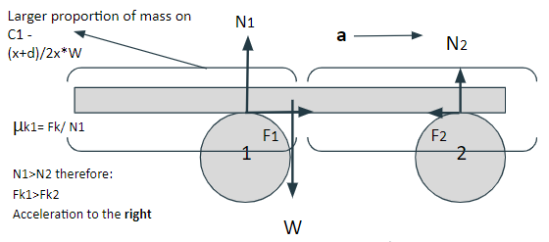
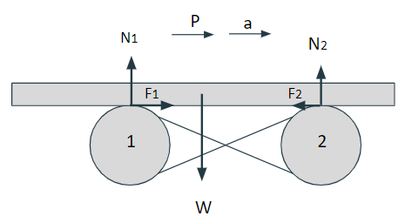
Factors affecting object’s behaviour
These sub-factors can be simplified into Main independent variables:
Mass distribution of object
Kinetic friction acting between surfaces
Displacement/ position of object from Equilibrium
Coefficient of friction between the object and the cylinder (different materials)
Shape of the object and the cylinders
Mass of object
Distance between cylinders
Speed of rotation of cylinders
Position of cylinders of surface
Contact area (depends on shape)

Slide 13
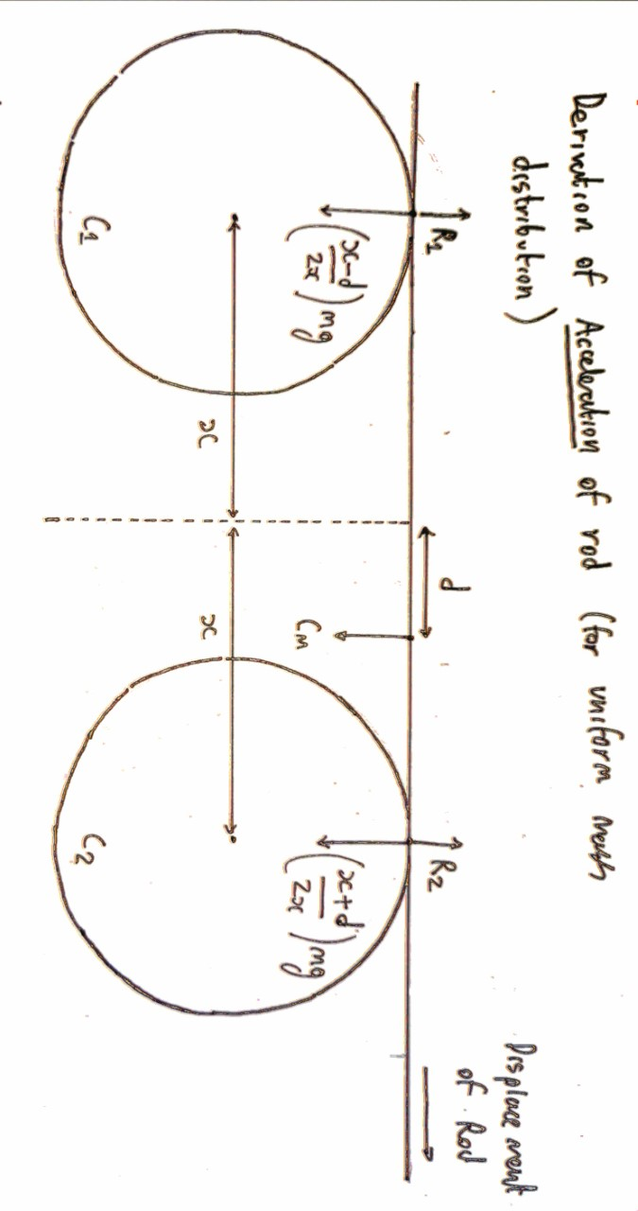
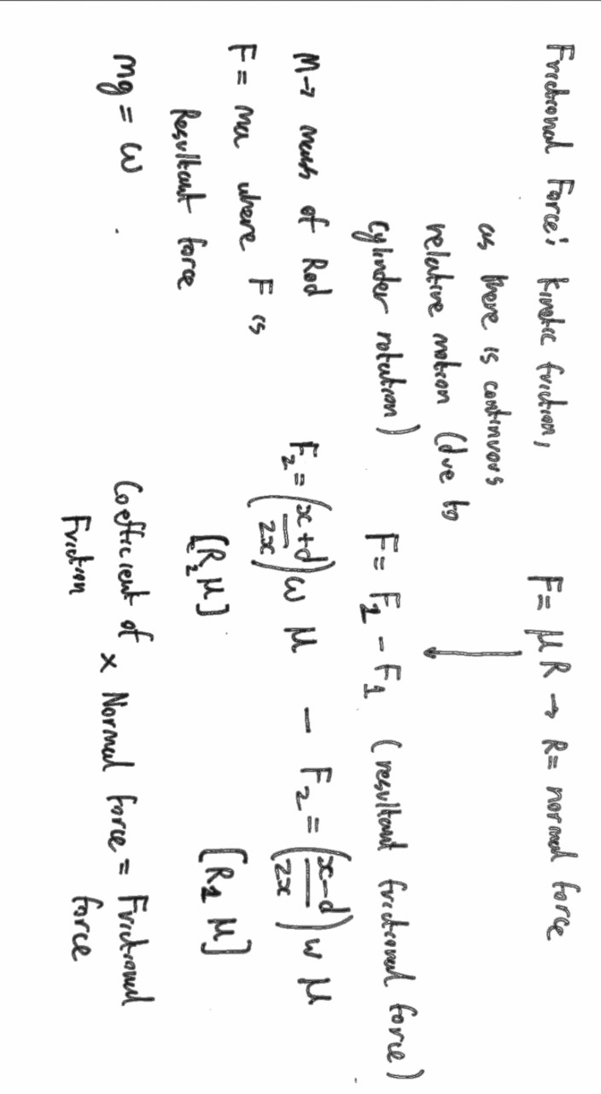
Derivation of acceleration of the Body
1. Using moments we derived the formula N = W*(x+-d)/2x, where x is half the distance between the points of interaction, d is displacement, W is the weight of the object, +- depends on the cylinder.
2. Therefore, friction forces would be Ff = W*μk*(x+-d)/2x, where μk is the coefficient of kinetic friction.
3. The net force would be Ff1 - Ff2 = d*W*μk/x, and it would be equal to Fnet = ma, where a is the acceleration of the object, m is object’s mass.
4. Hence we find that a = d*g*μk/x, where g is the gravitational constant.
Note: for the formula to work, while displacement tends to be a Vector - we only apply its magnitude, so is treated as a scalar

Slide 14
Deriving the frequency and period
Assumption: the movement of the object is Simple Harmonic Motion
Using the formula we derived for acceleration of the object, a = d*g*μk/x, and the formula of acceleration in SHM, we can say that d*(2*Pi*f)² = a = d* g*μk/x (displacement, d cancels out), where f is the frequency of oscillations:
From this we find that f = 1/(2*Pi)*(g*μk/x)^{1/2}
Hence the period T is T = 2*Pi*(x/(g*μk))^{1/2}
As we can see, both frequency and period are independent of the displacement.
http://physicsnet.co.uk/a-level-physics-as-a2/further-mechanics/simple-harmonic-motion-shm/

Slide 15
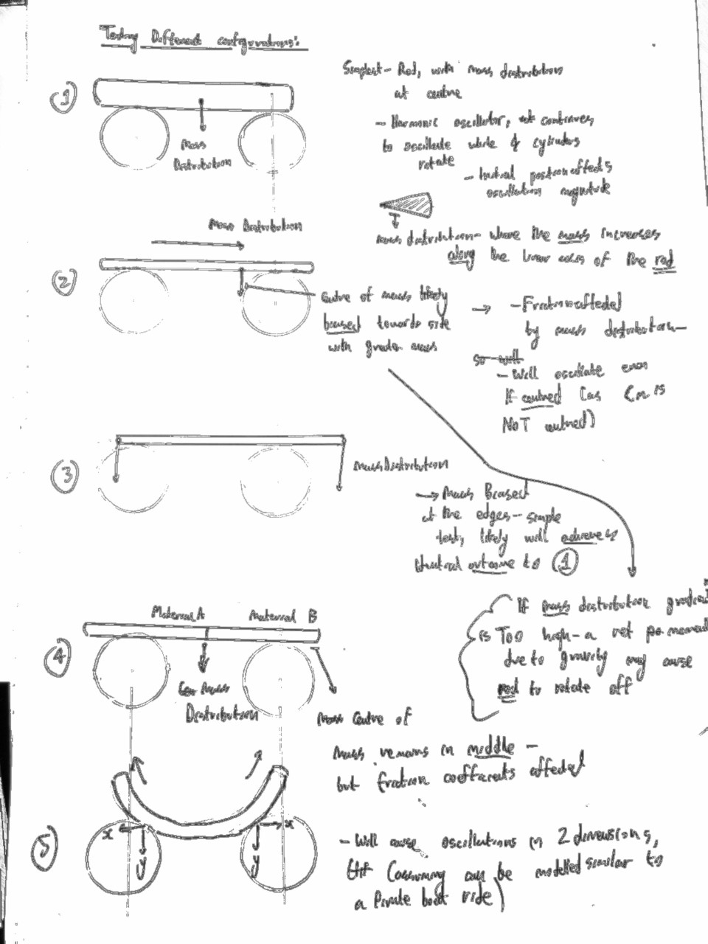
Configurations
1)Equal mass distribution along the cylinder - assuming constant density and volume along the rod’s axes
2)Gradient of mass distribution - this can be configured through construction of tight cavities into which masses can be placed (diagram on following slide)
3)Mass distribution - (large masses at the edges)
4)Materials along the axis of the rod - one material may be used on one half, while another on the other half
(for experimental consistency, the mass distribution will be kept at the centre - but the coefficients of friction will change)
5)2-Dimensional oscillations - through the use of a concave rod. friction acts along both axes -
Gravity will also play a part on oscillations, as well as frictional force
cylinder material
object material
object shape (rod1 or rod2 or plate)*
object mass (M1 or M2)
speed of rotation (S1 or S2)
distance between cylinders (D1 or D2)
position of cylinders (St (standard) or Dif (different))
*Rod1 is a rod of length L1, rod2 is a rod of L2

Slide 16
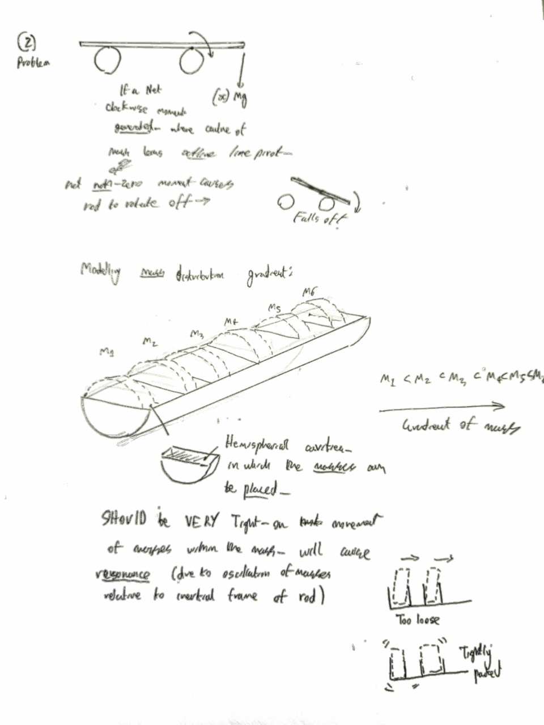
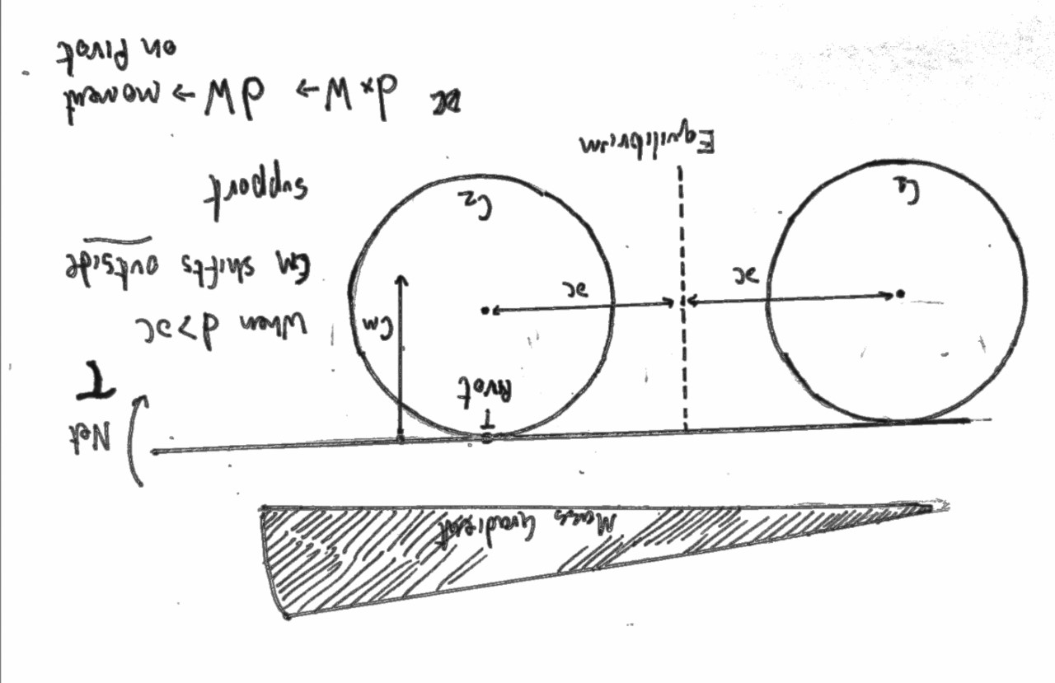
Mass distribution alteration
1.A hemi-cylindrical structure with cavities for placement of different mass discs will have to be constructed
Note: the discs must be placed in tightly, or the oscillations of the masses themselves will have a ‘resonance effect’ as the rod displacement will amplify when the masses shift in that direction
2.Theoretically, Centre of mass is what matters - but non central mass distribution will return a different Displacement graph
Gradient of mass distribution (can experiment different ways)
Theoretical problem - if the mass gradient is too large, the centre of mass may shift outside the geometric pivot (the surface of the cylinder) -
this may generate a net torque, causing the rod to fall off

Slide 17
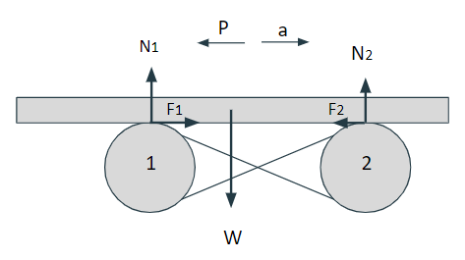
To test dependence on cylinders’ position:
Where the centre of mass of the rod lies at it’s geometric centre, there will be (theoretically) no oscillation:
F₁ = F₂ therefore, balancing of the frictional forces will inhibit the rod from motion (this excludes the model with different materials used, as mass distribution and the friction coefficient together affect the frictional force)
When the mass distribution is skewed towards towards one of the cylinders:
here, F₁>F₂ so a net force causes acceleration of the body, and the rod begins to oscillate
(in one of the above slides, the starting angle of the cylinder was also noted for experimentation)

Slide 18
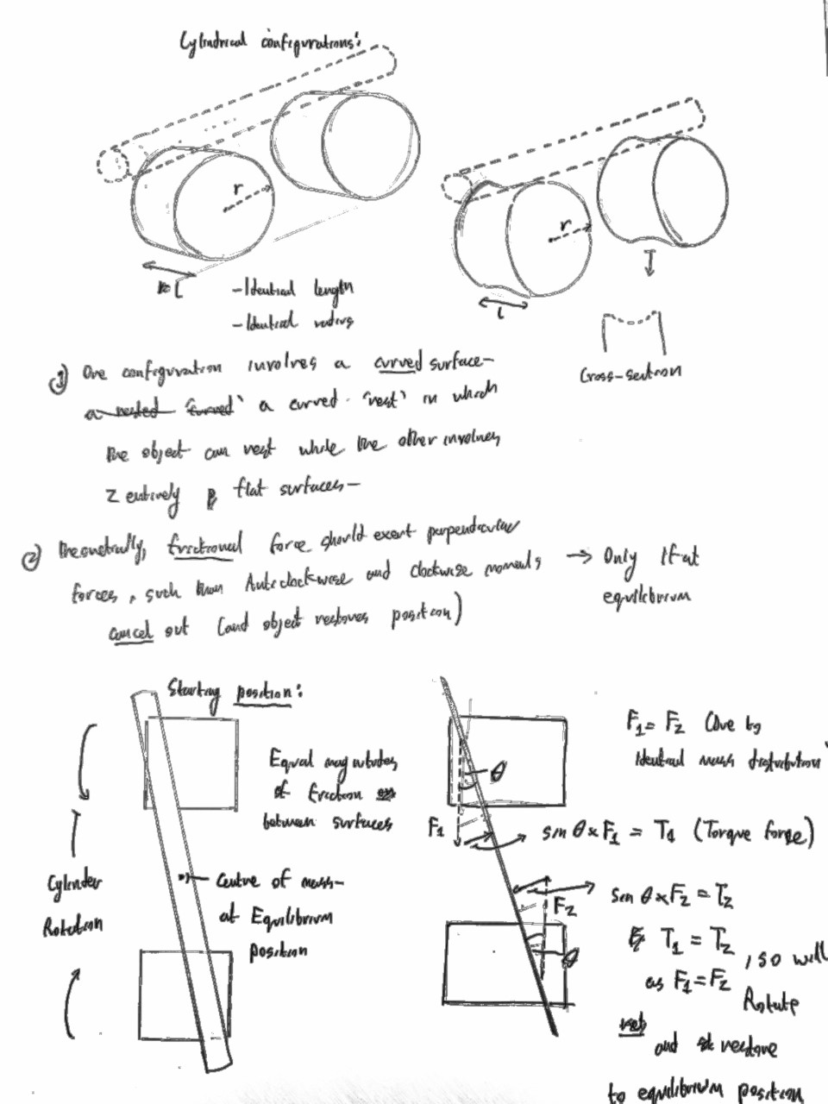
Cylindrical shapes and different starting positions
Cylindrical structures can also vary - the concave-nest configuration is ideal for cylindrical lock on the position (this is more for experimental convenience, as time may end up wasted on alignment of cylinder)
The flat surface is more more investigation of another phenomenon -
for a linear rod (as opposed to a parabolic), is a diagonal starting position may case 2 axes of oscillation-
-With centre of mass at equilibrium position - theoretically, a net torque should cause it to slight perpendicular to cylinders’ axes of rotation
-With centre of mass displaced from equilibrium position

Slide 19
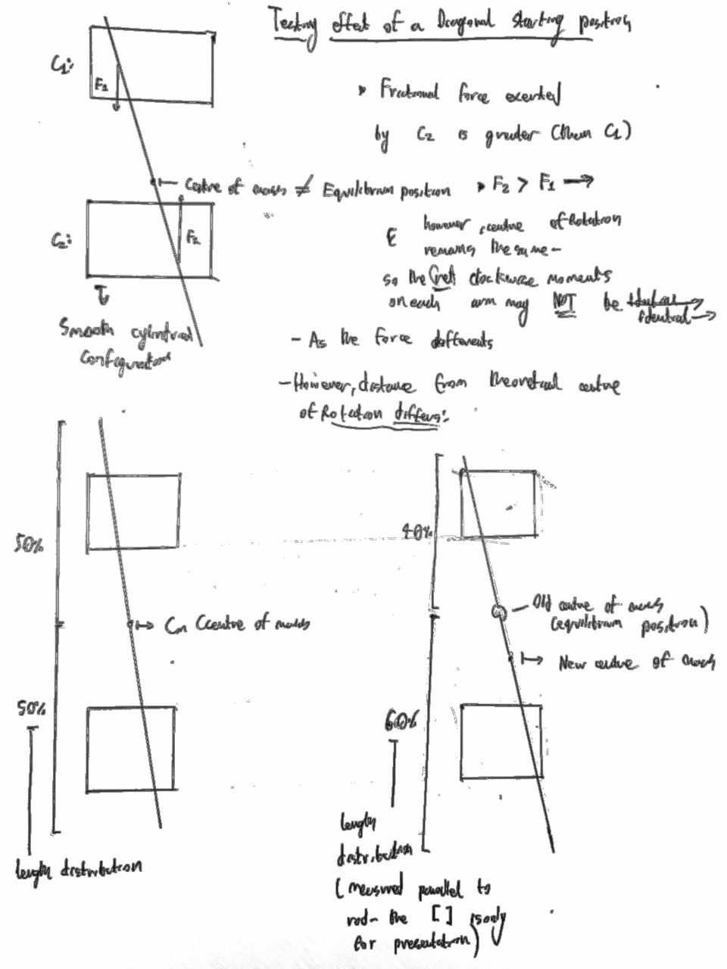
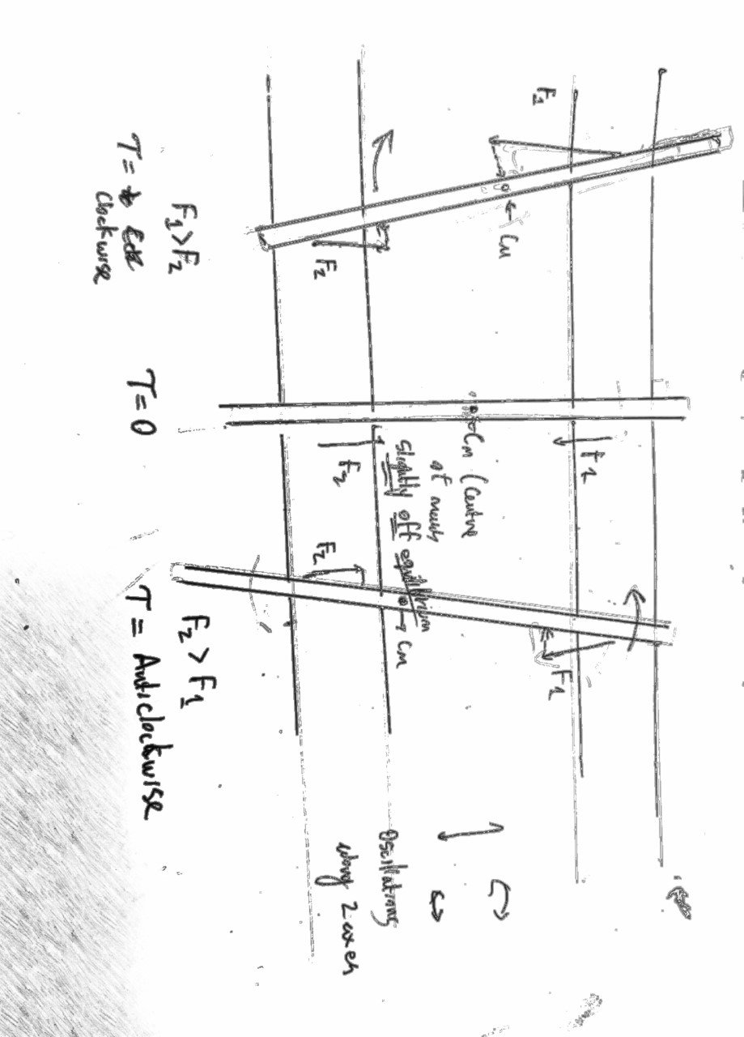
Testing different starting positions
For the cylinder to oscillate primarily, it must not have centre of mass at the equilibrium position (because F_{net} = 0)
Therefore, for an oblique starting position, with centre of mass NOT at equilibrium position:
cylinder may begin to shift transversely towards left maximum - but a net clockwise torque will cause rotation (at right maximum), which reverses as it approaches left max
when it oscillates back to right max, the centre of mass shifts, therefore will cause net torque to be anti-clockwise (causing a rotation in the other direction)

Slide 20
Research about the material of the objects and the cylinders that have different coefficients of friction
Assume that the F is the same(same masses of objects) Examples are given below:
A.Both the objects and the cylinders are made of steel (with the friction coefficient of 0.15)fs=μsF=0.15F
B.Both the objects and the cylinders are made of wood.(with the friction coefficient of 0.35)fw=μwF=0.35F
C.Both the objects and the cylinders are made of glass.(with the friction coefficient of 0.8)fg=μgF=0.8F --->Conclusion: fg>fw>fs
Friction Coefficients for some Common Materials and Materials Combinations
Now,here is a table below to show the friction coefficients for different material combinations.Click the link: https://www.engineeringtoolbox.com/friction-coefficients-d_778.html.
The main issue, is that it does not remain a perfectly harmonic oscillator, as the coefficient of friction between the materials changes - due to the sliding in between, and the Nylon used in 3d printing has a linear relationship to COF for 1-3m’s range: ------Sliding speed increase increases COF------- https://www.intechopen.com/books/composites-and-their-properties/friction-and-wear-of-polymer-and-composites
This change may be the reason - there is higher acceleration that expected (due to higher speed difference when rod is moving against rotation of cylinder), and the momentum gained from acceleration causes it to fall off.

Slide 21
To test coef. of kinetic friction dependence:
Testing different materials:
Metal, Plastic, Rubber, Wood? (While wood may be a practically possible option, physically the wear on the surface while affect friction as the material degrades)
Testing Shapes:
-Concave rod (parabolic)
-Linear rod
-Long/ short rods
However…
The oscillations comes down to mass distribution and frictional force, so the dependent variables are:
Frictional force, Mass distribution (centre of mass), Displacement
(and correspondingly, through modelling as circular motion of harmonic oscillator - we can find velocity and acceleration)
In relation to mass:
Mass is less of a test factor, as it is more the mass distribution that affects the oscillations -
mg = w, F is proportional to w
(until a limit. for practical purposes to large of a weight would have too large of an inertial mass to displace from its state of inertia)

Slide 22
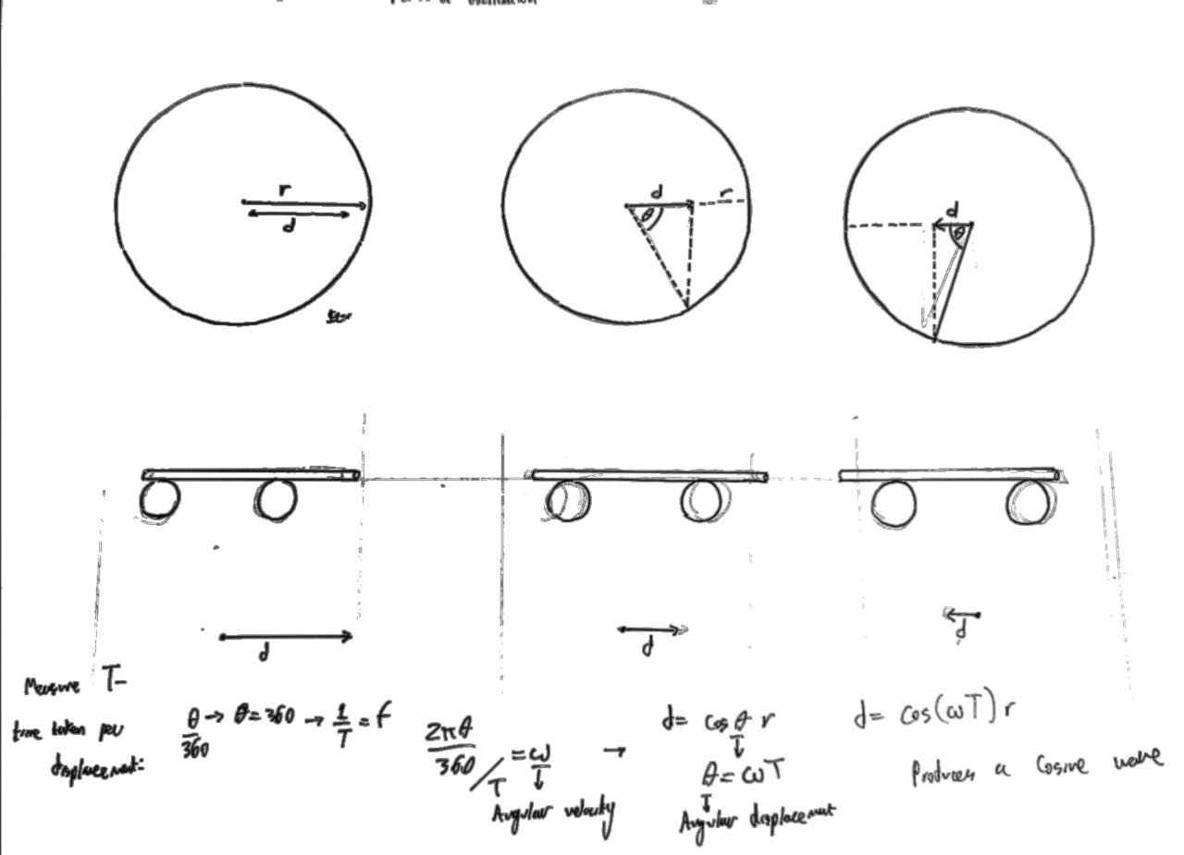
Mathematical representation of motion:
•The object’s motion can be modelled as a harmonic oscillator, and if we use the idea of it’s revolution as a circle. It’s motion can be depicted in the format of a sinusoidal wave function:
•Let t be the period of a full revolution – or oscillation, from max right, to max left to max right
•(2πθ/360)/T gives the angular velocity, where θ is the angular displacement (using the circle model) = ω
•ω = ((2πθ) )/360T can be defined as θ_{d}= Angular displacement
•The displacement of the object at time t is d – where, cos(d/r)=θ where r is the radius of the circle, or the max displacement of the oscillator from the equilibrium
*Approximate model of motion - since there is no hard grip between the cylinder and the object

Slide 23
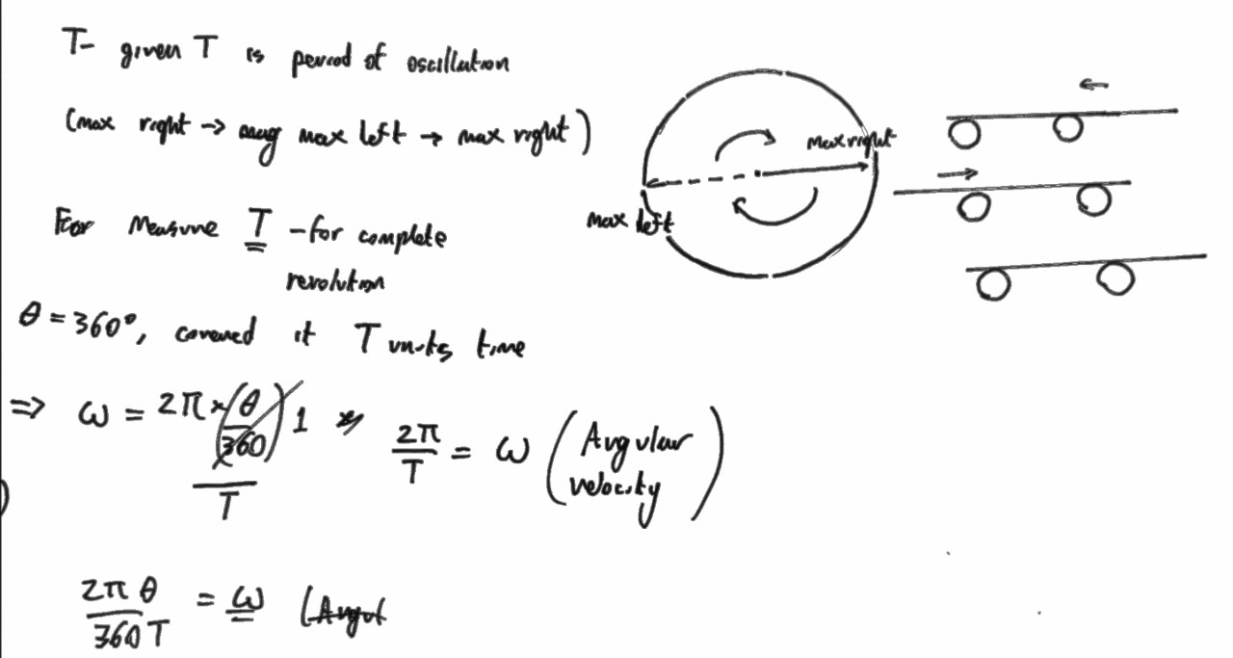
Modelling motion:
As a result, d = rcos(θ), as θ is angular displacement at time t, it can be given by ωT
=> s = cos⁡(ωt)r – ∂(s)/∂(t)
•Velocity: -ωrsin⁡(ωt)
•Acceleration: -ω^2(rcos(ωt) ) – the acceleration at the start must of course be non-zero due to rotation of cylinders
We will investigate if this model as a simple harmonic oscillator (excluding slip) will function for all experimental configurations (in single dimensions of oscillation) - if the pattern is too irregular, the modelling of motion will have to be computerised

Slide 24
Equipment
Metal/ Glass/ Rubber/Plastic* Rods (and a Plastic/ metal Parabolic rod -
Metal gears with a Roller Chain configuration
High torque DC motor
Chassis for the cylinders (3D printed and/or created - metals ideally due to plasticity of normal plastics affecting integrity)
High resolution camera and Motion tracking software for measurements of displacement and velocity
Flat electric weight scales to measure the distribution of masses (forces) over the two cylinders during oscillations
Set up for an experiment to measure coef. of kinetic friction between different materials
Ruler/ Vernier Caliper to measure dimensions of the Objects
*Plastic should be a Thermoplastic, with high density, PMMA or PVC is ideal (to reduce effects of temperature of structure)

Slide 25
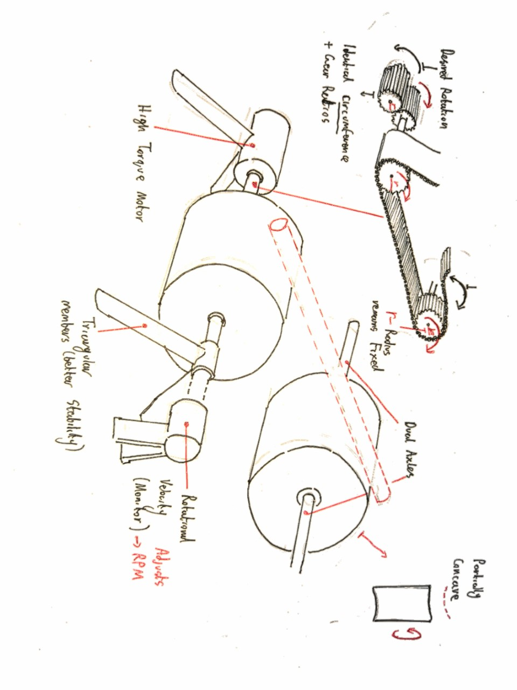
Experimental procedure
High torque motor used for controlling the rotation of the Cylinders
A generator will be attached on the other side - so current input can be used to measure the rotational velocity- used to monitor RPM, and will control current flow to adjust RPM
Trigonal members for greater support - and axles on both sides
Non-slip gear chain used, with alternating gears so the cylinders rotate in opposite directions
High resolution camera input to computer - for motion tracking, used for measurements of displacement with respect to time

Slide 26
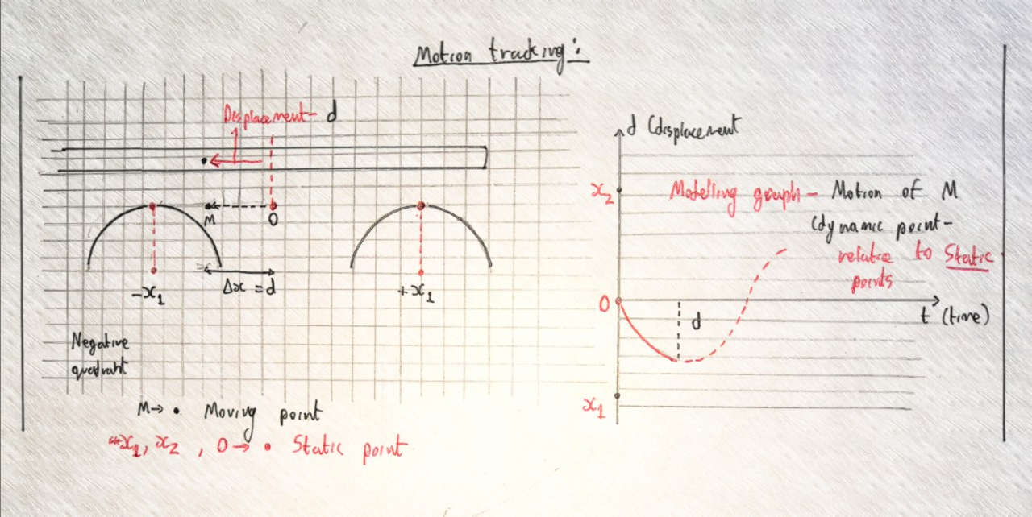
Exact experimental procedure and Data collection systems
Data collection:
1)Light gate (we can put small slits of negligible mass on top of the rods, and measure their acceleration - and see if it matches theoretical acceleration) - or to measure oscillations of extremely small magnitude, we can use ultrasonic sensors or IR emission (at one end of the rod)
2)Simpest: use very high resolution camera where the only limiting uncertainty is resolution, and use it to track the motion (and draw a graph with respect to time)
Repeated graphs - and create a ‘mean’ graph by taking a mean of coordinates of each point
https://www.ssontech.com/download.html or https://borisfx.com/products/mocha-pro/ - Syntheyes pro or Mocha pro (or similar motion tracking tools for Real-time graph composition)
*Camera must be isolated from the surface of the system to minimise disturbances form oscillations

Slide 27
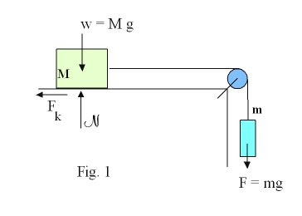
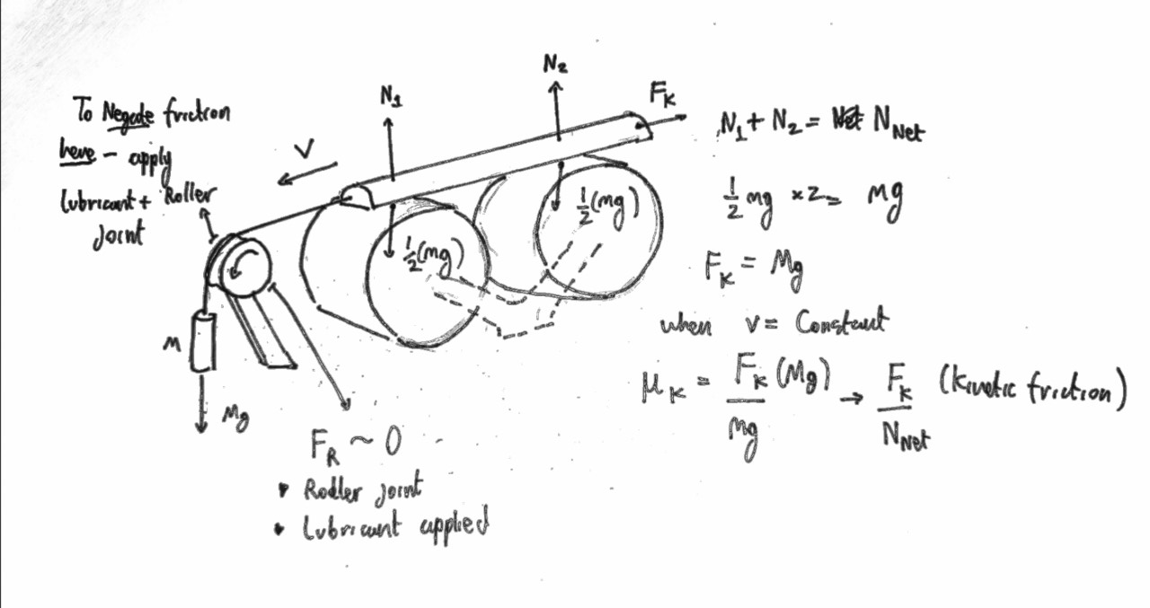
Sub-experiment for testing the coefficient of friction
*Mathematically infinitely small surface area contact - taking into account the Young’s modulus of each body, there is a partial stress-induced compression that creates a larger surface area
-Mg is the force accelerating the body
-mg is the Normal force - coefficient of friction can be calculated:
F_{s/k} = Mg (weight of mass)
-F_{k} only remains Kinetic when the body is in Uniform velocity → as μk = F_{k}/ mg given that Mg = mg and V ≠ 0
μk = F_{k}/ mg, where mg = N (normal force)
-We can use a Light gate to measure if the body is in a state of Uniform Velocity (due to gravity a ≠ 0 which we can reduce by minimising M value (for minimal velocity)
Tasin, check out my comment

Slide 28
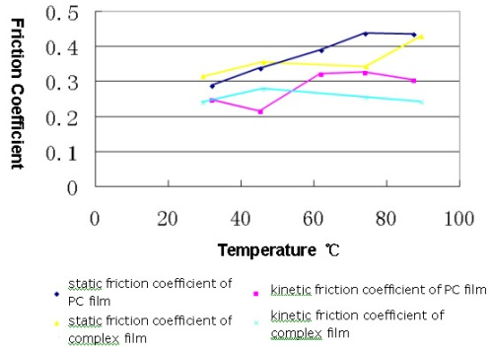
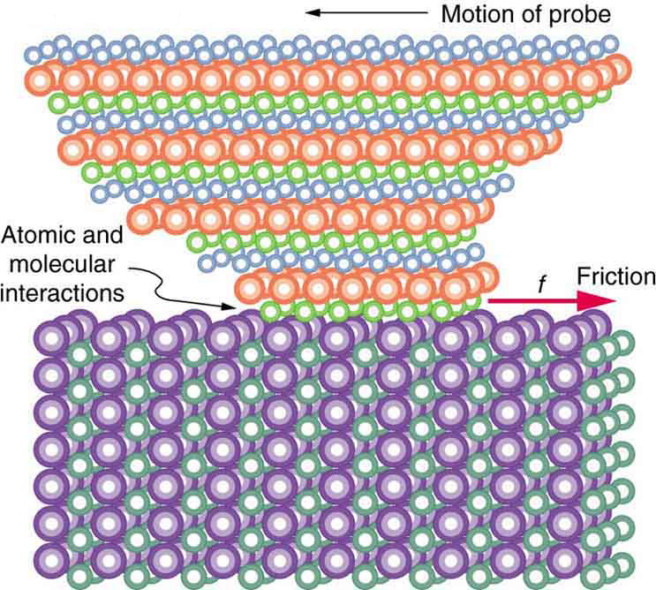
Temperature on the effects of friction - can be ignored due to relatively low speeds and masses,
Sample diagram of effect:
-The oscillations will be recorded for a relatively short period of time - but heating effects as a result of friction may cause surface heating -This will result in thermal expansion of the material, so greater compression and larger surface area of contact increases the frictional force acting between them
-This is also a primary reason for using High Density thermoplastic to minimise polymer expansion -Surface thermometer or Infrared camera used for monitoring
To minimize the effects:
1)Air based cooling system or environment air condition in sync with temperature increase (for constant thermal gradient)
2)Mathematical exclusion of the thermal expansion on the coefficient of friction

Slide 29
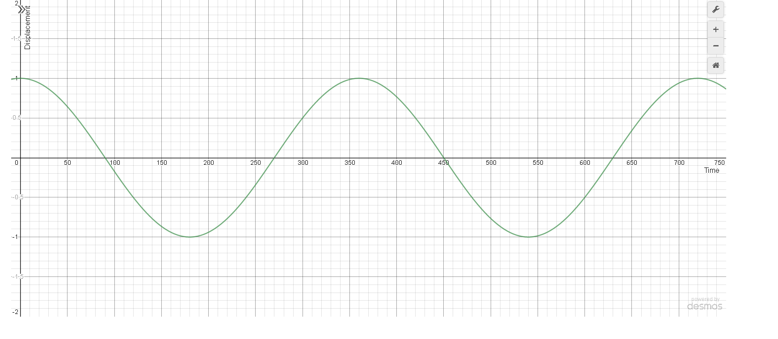
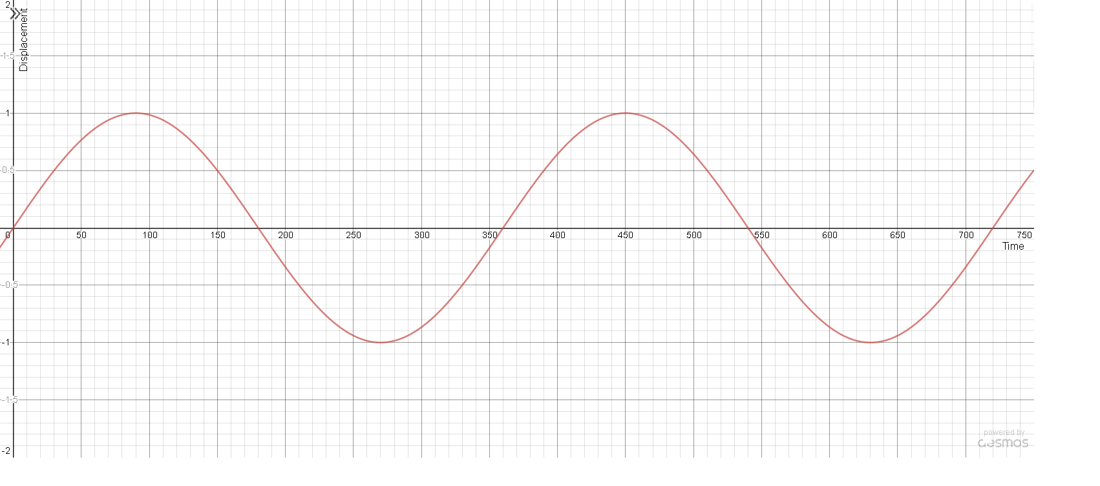
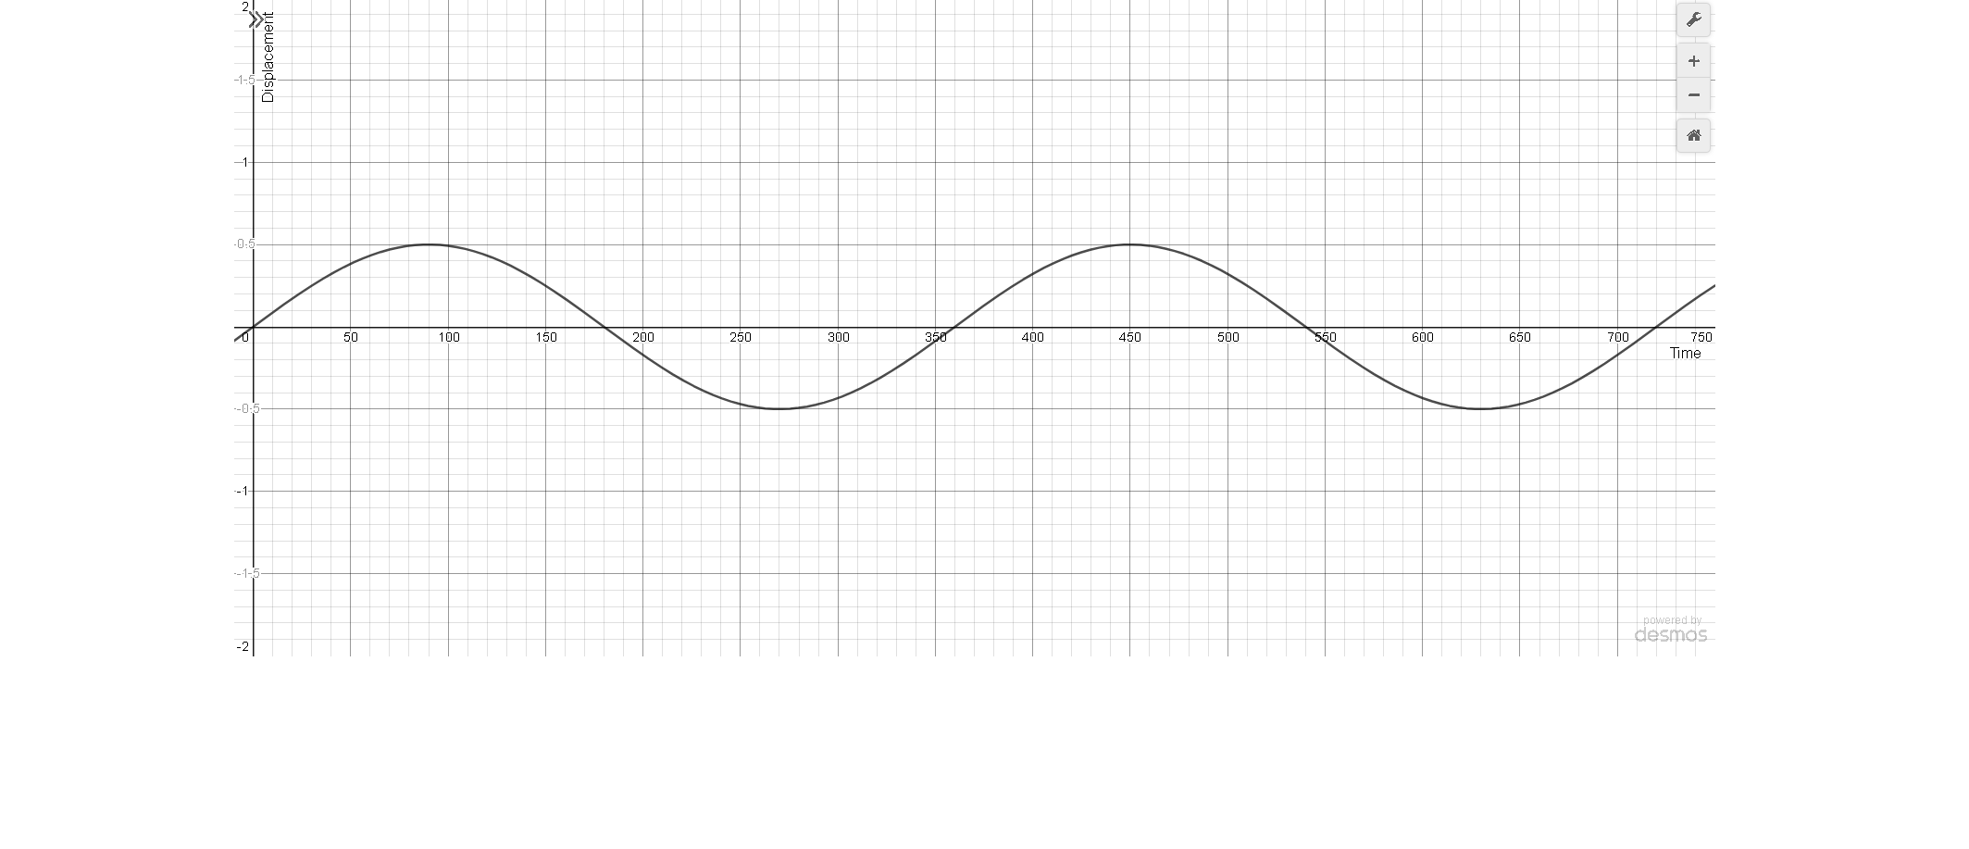
Predicted Graph Shapes (but not scales) from experimental data
Displacement = s
Velocity = v
Acceleration = a
s vs. t, at t = 0 -> s = max
s vs. t, at t = 0 -> s = 0
s vs. t, at t = 0 -> s = 0, ½ frictional coefficient

Slide 30
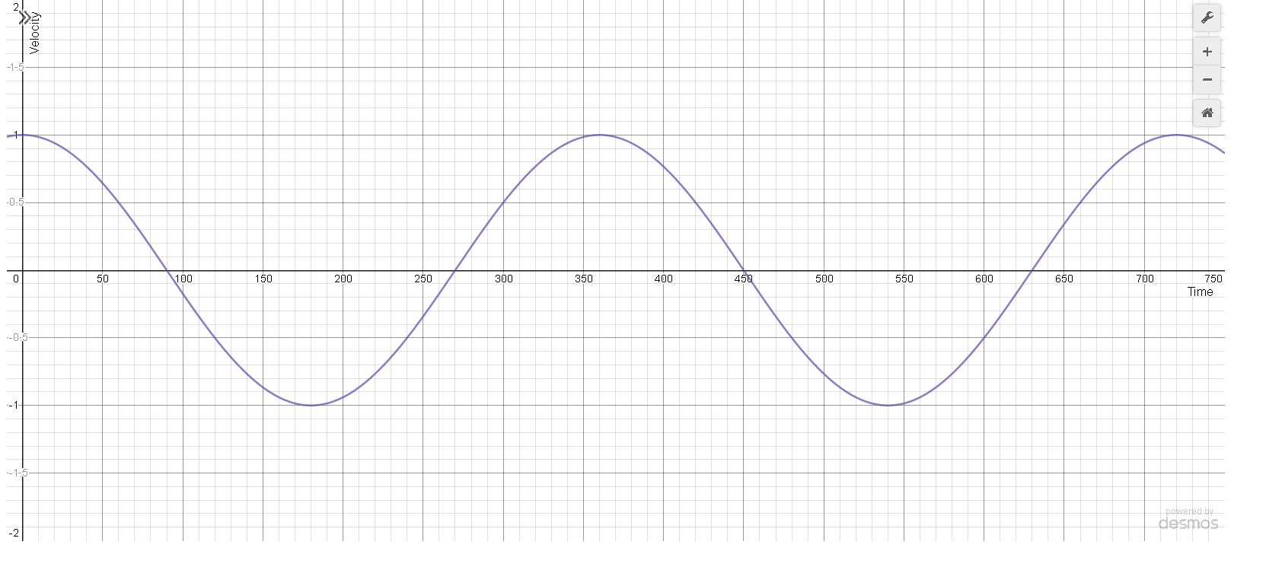
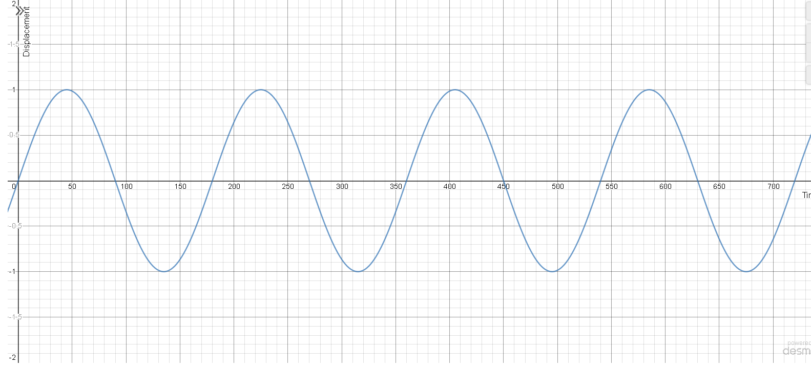
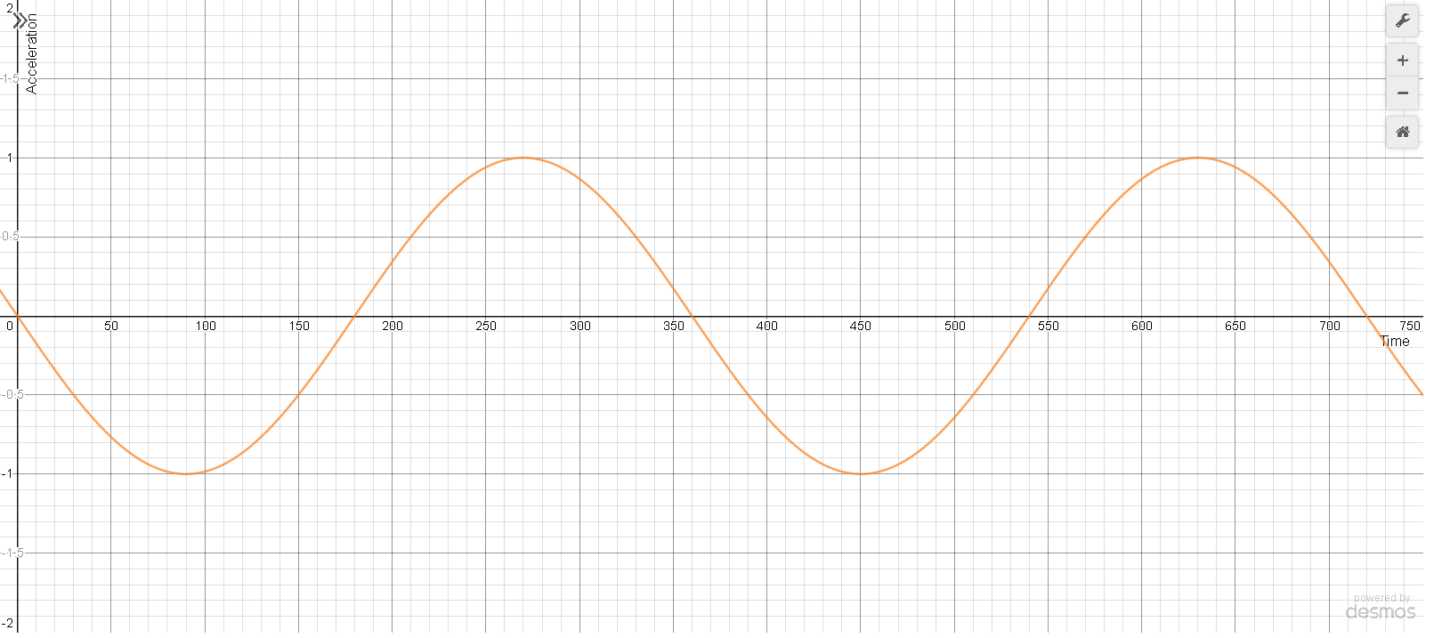
Predicted Graphs
Displacement = s
Velocity = v
Acceleration = a
v vs. t, at t = 0 -> s = max
s vs. t, at t = 0 -> s = 0
a vs. t, at t = 0 -> s = 0, ½ coefficient of friction

Slide 31
Graphs of oscillations
-Oscillations should follow simple harmonic motion if the conditions are purely based on weight, with differing amplitudes for each material - due to differing coefficient of friction and weight force
-But- the coefficient of friction is dynamic, not static (not referring to static friction), meaning ti chnages as the sliding speed between rod and cylinders change
-Coefficient follows a curve- and dependent on material, this curve can differ, and be translated left or right which is why at low velocities, some materials oscillate, even accelerate off, while other materials decelerate and stop - and vice versa at higher velocities
-Wegith force governs the oscillation - μk = F_{k}/ mg however μk plays a role in whether the rod accelerates and decelerates, thermal effects can be neglected due to relatively low velocities and weight between the materials
Note: some erosion of the surface of the cylinders may have affected data, but this was negligible as it shouldn’t affect the material coefficient of friction, and all materials were sanded to minimise irregularities

